Slide 1
Processes
Some slides were taken from John Kubiatowicz’s Notes, UC Berkely

Slide 2
Four Fundamental OS Concepts
Thread: Execution Context
Fully describes program state
Program Counter, Registers, Execution Flags, Stack
Address space (with or w/o translation)
Set of memory addresses accessible to program (for read or write)
May be distinct from memory space of the physical machine (in which case programs operate in a virtual address space)
Process: an instance of a running program
Protected Address Space + One or more Threads
Dual mode operation / Protection
Only the “system” has the ability to access certain resources
Combined with translation, isolates programs from each other and the OS from programs

Slide 3

OS Bottom Line: Run Programs
0xFFF…
Executable
Program Source
OS
int main()
{ … ;
}
compiler
data
Load & Execute
stack
editor
Memory
instructions
heap
a.out
data
foo.c
Create OS “PCB”, address space, stack and heap
Load instruction and data segments of executable file into memory
“Transfer control to program”
Provide services to program
While protecting OS and program
instructions
0x000…
PC:
registers
Processor

Slide 4
Protected Address Space
Program operates in an address space that is distinct from the physical memory space of the machine
“physical address”
0x000…
“virtual address”
Processor
translator
Memory
Registers
Page Table
<Frame Addr>
0xFFF…

Slide 5
How to provide the illusion of many CPUs?
CPU virtualizing
The OS can promote the illusion that many virtual CPUs exist.
Time sharing: Running one process, then stopping it and running another
The potential cost is performance.

Slide 6
A Process
Comprising of a process:
Memory (address space)
Instructions
Data section
Registers
Program counter
Stack pointer
A process is a running program.

Slide 7
Process API
These APIs are available on any modern OS.
Create
Create a new process to run a program
Destroy
Halt a runaway process
Wait
Wait for a process to stop running
Miscellaneous Control
Some kind of method to suspend a process and then resume it
Status
Get some status info about a process

Slide 8
Process Creation
Load a program code into memory, into the address space of the process.
Programs initially reside on disk in executable format.
OS perform the loading process lazily.
Loading pieces of code or data only as they are needed during program execution.
The program’s run-time stack is allocated.
Use the stack for local variables, function parameters, and return address.
Initialize the stack with arguments → argc and the argv array of main() function

Slide 9
Process Creation (Cont.)
The program’s heap is created.
Used for explicitly requested dynamically allocated data.
Program request such space by calling malloc() and free it by calling free().
The OS do some other initialization tasks.
input/output (I/O) setup
Each process by default has three open file descriptors.
Standard input, output and error
Start the program running at the entry point, namely main().
The OS transfers control of the CPU to the newly-created process.

Slide 10
Loading: From Program To Process
CPU
Memory
code
static data
heap
stack
Process
Loading:
Takes on-disk program
and reads it into the address space of process
code
static data
heap
Program
Disk

Slide 11
Process States
A process can be one of three states.
Running
A process is running on a processor.
Ready
A process is ready to run but for some reason the OS has chosen not to run it at this given moment.
Blocked
A process has performed some kind of operation.
When a process initiates an I/O request to a disk, it becomes blocked and thus some other process can use the processor.

Slide 12
Process State Transition
Running
Ready
Descheduled
Scheduled
I/O: initiate
I/O: done
Blocked

Slide 13
Data structures
The OS has some key data structures that track various relevant pieces of information.
Process list
Ready processes
Blocked processes
Current running process
Register context
PCB(Process Control Block)
A C-structure that contains information about each process.

Slide 14
Example: The xv6 kernel Proc Structure
// the registers xv6 will save and restore
// to stop and subsequently restart a process
struct context {
int eip; // Index pointer register
int esp; // Stack pointer register
int ebx; // Called the base register
int ecx; // Called the counter register
int edx; // Called the data register
int esi; // Source index register
int edi; // Destination index register
int ebp; // Stack base pointer register
};
// the different states a process can be in
enum proc_state { UNUSED, EMBRYO, SLEEPING,
RUNNABLE, RUNNING, ZOMBIE };

Slide 15
// the information xv6 tracks about each process
// including its register context and state
struct proc {
char *mem; // Start of process memory
uint sz; // Size of process memory
char *kstack; // Bottom of kernel stack
// for this process
enum proc_state state; // Process state
int pid; // Process ID
struct proc *parent; // Parent process
void *chan; // If non-zero, sleeping on chan
int killed; // If non-zero, have been killed
struct file *ofile[NOFILE]; // Open files
struct inode *cwd; // Current directory
struct context context; // Switch here to run process
struct trapframe *tf; // Trap frame for the
// current interrupt
};

Slide 16
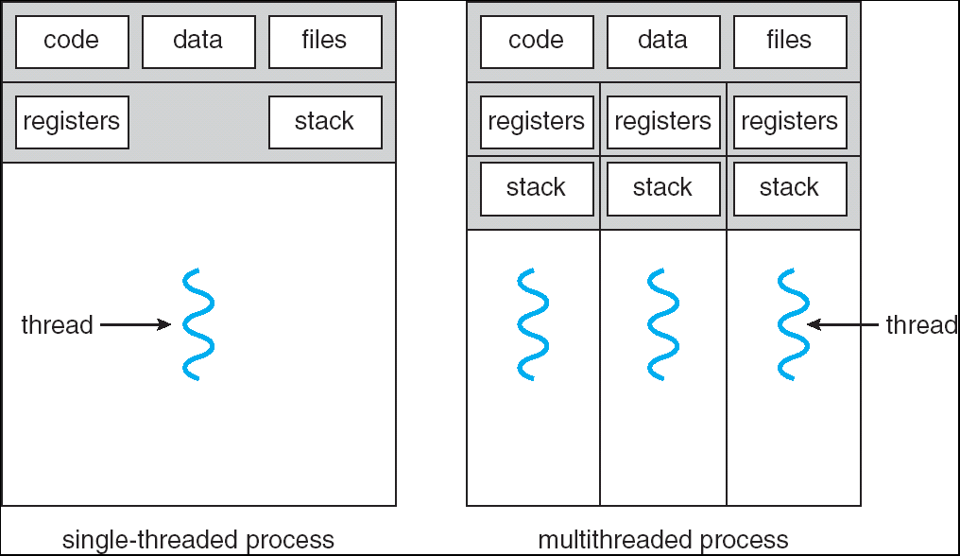
Single and Multithreaded Processes
Threads encapsulate concurrency: “Active” component
Address spaces encapsulate protection: “Passive” part
Keeps buggy program from trashing the system
Why have multiple threads per address space?
Notes:
Sometimes need parallelism for a single job, and processes are very expensive – to start, switch between, and to communicate between

Slide 17
Running Many Programs
We have the basic mechanism to
switch between user processes and the kernel,
the kernel can switch among user processes,
Protect OS from user processes and processes from each other
Questions ???
How do we represent user processes in the OS?
How do we decide which user process to run?
How do we pack up the process and set it aside?
How do we get a stack and heap for the kernel?
Aren’t we wasting are lot of memory?

Slide 18
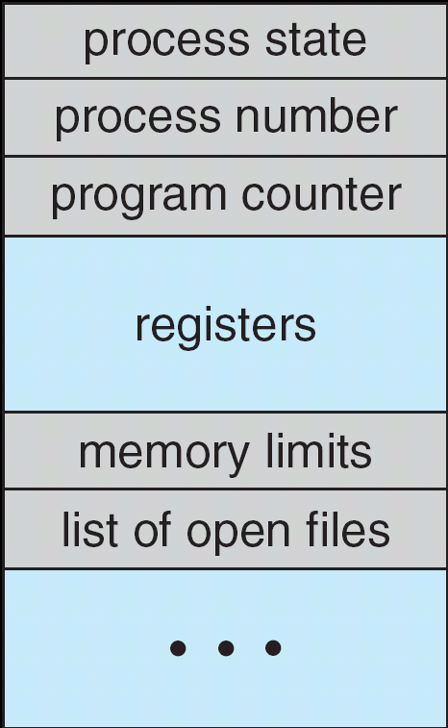
Multiplexing Processes: The Process Control Block
Kernel represents each process as a process control block (PCB)
Status (running, ready, blocked, …)
Register state (when not ready)
Process ID (PID), User, Executable, Priority, …
Execution time, …
Memory space, translation, …
Kernel Scheduler maintains a data structure containing the PCBs
Give out CPU to different processes
This is a Policy Decision
Give out non-CPU resources
Memory/IO
Another policy decision
Process Control
Block

Slide 19
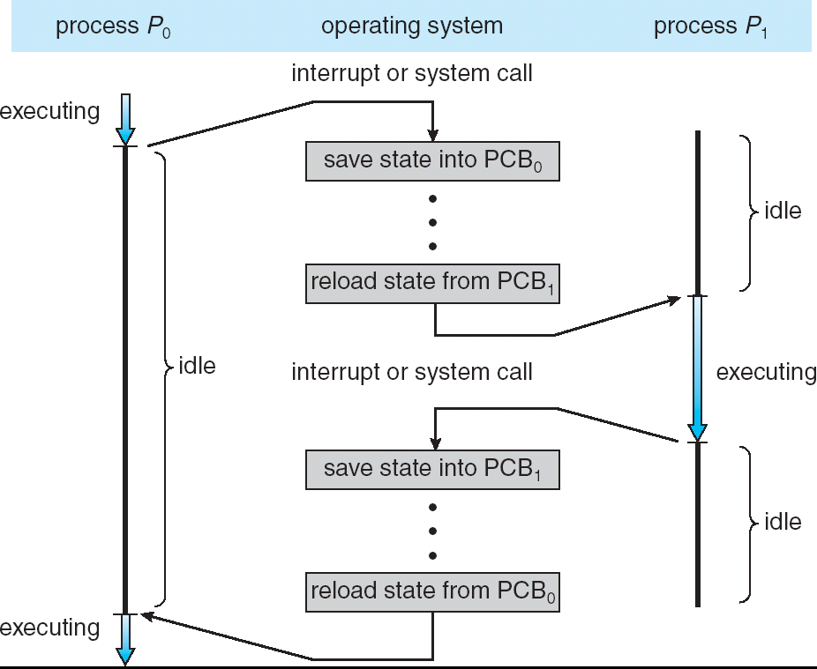
CPU Switch From Process A to Process B
User Mode
Kernel/System Mode
User Mode

Slide 20
Scheduler
if ( readyProcesses(PCBs) ) {
nextPCB = selectProcess(PCBs);
run( nextPCB );
} else {
run_idle_process();
}
Scheduling: Mechanism for deciding which processes/threads receive the CPU
Lots of different scheduling policies provide …
Fairness or
Realtime guarantees or
Latency optimization or ..

Slide 21
3 types of Kernel Mode Transfer
Syscall
Process requests a system service, e.g., exit
Like a function call, but “outside” the process
Does not have the address of the system function to call
Like a Remote Procedure Call (RPC) – for later
Marshall the syscall id and args in registers and exec syscall
Interrupt
External asynchronous event triggers context switch
eg. Timer, I/O device
Independent of user process
Trap or Exception
Internal synchronous event in process triggers context switch
e.g., Protection violation (segmentation fault), Divide by zero, …

Slide 22
User/Kernel (Privileged) Mode
User Mode
interrupt
exception
syscall
rtn
rfi
Kernel Mode
exit
exec
Limited HW access
Full HW access

Slide 23
Implementing Safe Kernel Mode Transfers
Important aspects:
Controlled transfer into kernel (e.g., syscall table)
Separate kernel stack!
Carefully constructed kernel code packs up the user process state and sets it aside
Details depend on the machine architecture
More on this next time
Should be impossible for buggy or malicious user program to cause the kernel to corrupt itself!

Slide 24
Hardware support: Interrupt Control
Interrupt processing not visible to the user process:
Occurs between instructions, restarted transparently
No change to process state
What can be observed even with perfect interrupt processing?
Interrupt Handler invoked with interrupts ‘disabled’
Re-enabled upon completion
Non-blocking (run to completion, no waits)
Pack up in a queue and pass off to an OS thread for hard work
wake up an existing OS thread

Slide 25
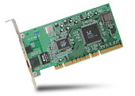
Interrupt Controller
Interrupt Mask
Priority Encoder
IntID
CPU
Interrupt
Int Disable
Timer
Software
Interrupt
Control
NMI
Network
Interrupts invoked with interrupt lines from devices
Interrupt controller chooses interrupt request to honor
Interrupt identity specified with ID line
Mask enables/disables interrupts
Priority encoder picks highest enabled interrupt
Software Interrupt Set/Cleared by Software
CPU can disable all interrupts with internal flag
Non-Maskable Interrupt line (NMI) can’t be disabled

Slide 26
Interrupt Vector
Address and properties of each interrupt handler
interrupt number (i)
intrpHandler_i () {
….
}
Where else do you see this dispatch pattern?
System Call
Exceptions

Slide 27
How do we take interrupts safely?
Interrupt vector
Limited number of entry points into kernel
Kernel interrupt stack
Handler works regardless of state of user code
Interrupt masking
Handler is non-blocking
Atomic transfer of control
“Single instruction”-like to change:
Program counter
Stack pointer
Memory protection
Kernel/user mode
Transparent restartable execution
User program does not know interrupt occurred

Slide 28
Need for Separate Kernel Stacks
Kernel needs space to work
Cannot put anything on the user stack (Why?)
Two-stack model
OS thread has interrupt stack (located in kernel memory) plus User stack (located in user memory)
Syscall handler copies user args to kernel space before invoking specific function (e.g., open)
Interrupts (???)

Slide 29
Before

Slide 30
During Interrupt/System Call

Slide 31
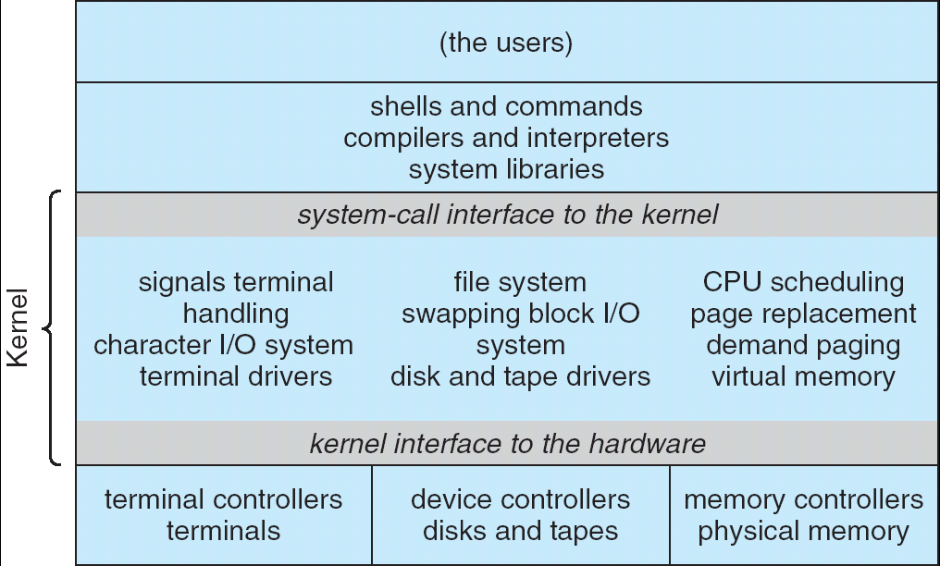
UNIX System Structure
Applications
User Mode
Standard Libs
Kernel Mode
Hardware

Slide 32
A Narrow Waist
Word Processing
Compilers
Web Browsers
Email
Databases
Web Servers
Application / Service
Portable OS Library
OS
User Mode
System Call
Interface
System Mode
Portable OS Kernel
Software
Platform support, Device Drivers
Hardware
x86
PowerPC
ARM
PCI
Ethernet (1Gbs/10Gbs)
802.11 a/g/n/ac/ax
SCSI
Graphics
Thunderbolt

Slide 33
Kernel System Call Handler
Vector through well-defined syscall entry points!
Table mapping system call number to handler
Locate arguments
In registers or on user (!) stack
Copy arguments
From user memory into kernel memory
Protect kernel from malicious code evading checks
Validate arguments
Protect kernel from errors in user code
Copy results back
Into user memory

Slide 34
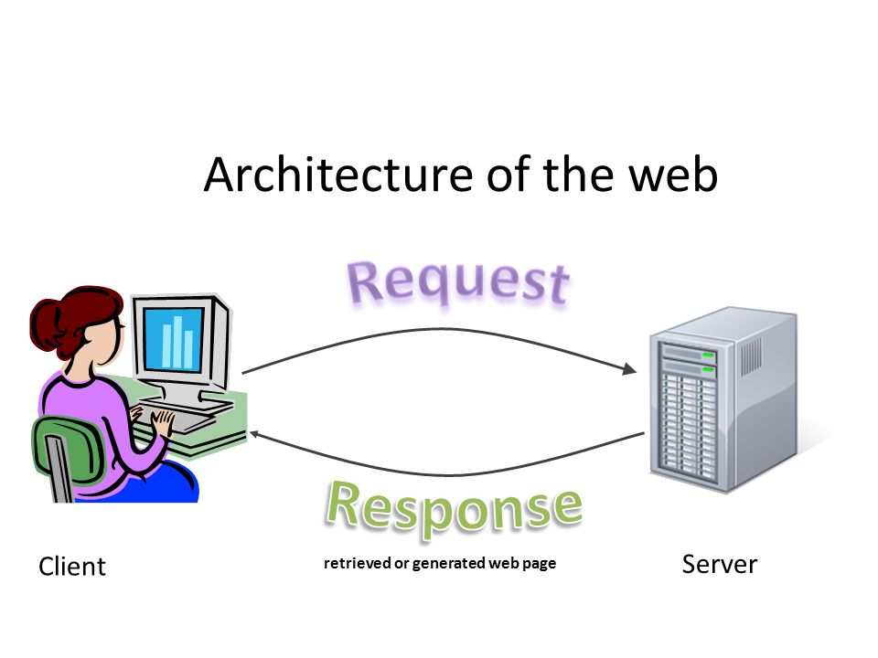
Putting it together: web server
Request
Reply
(retrieved by web server)
Client
Web Server

Slide 35
Putting it together: web server
Server Process
4. parse request
9. format reply
request
buffer
reply
buffer
network
socket
read()
3. kernel
copy
10. network
socket
write()
5. file
read()
8. kernel
copy
Kernel
syscall
RTU
syscall
syscall
RTU
wait
wait
11. kernel copy
from user buffer
to network buffer
2. copy arriving
packet (DMA)
interrupt
interrupt
12. format outgoing
packet and DMA
6. disk
request
7. disk data
(DMA)
Hardware
Network
interface
Disk interface
Request
Reply

Slide 36
Bootstrapping
If processes are created by other processes, how does the first process start?
First process is started by the kernel
Often configured as an argument to the kernel before the kernel boots
Often called the “init” process
After this, all processes on the system are created by other processes

Slide 37
Process Management API
exit – terminate a process
fork – copy the current process
exec – change the program being run by the current process
wait – wait for a process to finish
kill – send a signal (interrupt-like notification) to another process
sigaction – set handlers for signals

Slide 38
What API does the OS provide to user programs
API = Application Programming Interface
= functions available to write user programs
API provided by OS is a set of “system calls”
System call is a function call into OS code that runs at a higher privilege level of the CPU
Sensitive operations (e.g., access to hardware) are allowed only at a higher privilege level
Some “blocking” system calls cause the process to be blocked and descheduled (e.g., read from disk)

Slide 39
So, Should we rewrite programs for each OS?
POSIX API: a standard set of system calls that an OS must implement
Programs written to the POSIX API can run on any POSIX compliant OS
Most modern OSes are POSIX compliant
Ensures program portability
Program language libraries hide the details of invoking system calls
The printf function in the C library calls the write system call to write to screen
User programs usually do not need to worry about invoking system calls

Slide 40
Process Management API
exit – terminate a process
fork – copy the current process
exec – change the program being run by the current process
wait – wait for a process to finish
kill – send a signal (interrupt-like notification) to another process
sigaction – set handlers for signals

Slide 41
pid.c
#include <stdlib.h>
#include <stdio.h>
#include <string.h>
#include <unistd.h>
#include <sys/types.h>
int main(int argc, char *argv[])
{
/* get current processes PID */
pid_t pid = getpid();
printf("My pid: %d\n", pid);
exit(0);
}
Q: What if we let main return without ever calling exit?
The OS Library calls exit() for us!
The entrypoint of the executable is in the OS library
OS library calls main
If main returns, OS library calls exit
You’ll see this in Project 0: init.c

Slide 42
Process Management API
exit – terminate a process
fork – copy the current process
exec – change the program being run by the current process
wait – wait for a process to finish
kill – send a signal (interrupt-like notification) to another process
sigaction – set handlers for signals

Slide 43
Creating Processes
pid_t fork() – copy the current process
New process has different pid
New process contains a single thread
Return value from fork(): pid (like an integer)
When > 0:
Running in (original) Parent process
return value is pid of new child
When = 0:
Running in new Child process
When < 0:
Error! Must handle somehow
Running in original process
State of original process duplicated in both Parent and Child!
Address Space (Memory), File Descriptors (covered later), etc…

Slide 44
fork1.c
#include <stdlib.h>
#include <stdio.h>
#include <unistd.h>
#include <sys/types.h>
int main(int argc, char *argv[]) {
pid_t cpid, mypid;
pid_t pid = getpid(); /* get current processes PID */
printf("Parent pid: %d\n", pid);
cpid = fork();
if (cpid > 0) { /* Parent Process */
mypid = getpid();
printf("[%d] parent of [%d]\n", mypid, cpid);
} else if (cpid == 0) { /* Child Process */
mypid = getpid();
printf("[%d] child\n", mypid);
} else {
perror("Fork failed");
}
}

Slide 45
fork1.c
#include <stdlib.h>
#include <stdio.h>
#include <unistd.h>
#include <sys/types.h>
int main(int argc, char *argv[]) {
pid_t cpid, mypid;
pid_t pid = getpid(); /* get current processes PID */
printf("Parent pid: %d\n", pid);
cpid = fork();
if (cpid > 0) { /* Parent Process */
mypid = getpid();
printf("[%d] parent of [%d]\n", mypid, cpid);
} else if (cpid == 0) { /* Child Process */
mypid = getpid();
printf("[%d] child\n", mypid);
} else {
perror("Fork failed");
}
}
c
p

Slide 46
fork1.c
#include <stdlib.h>
#include <stdio.h>
#include <unistd.h>
#include <sys/types.h>
int main(int argc, char *argv[]) {
pid_t cpid, mypid;
pid_t pid = getpid(); /* get current processes PID */
printf("Parent pid: %d\n", pid);
cpid = fork();
if (cpid > 0) { /* Parent Process */
mypid = getpid();
printf("[%d] parent of [%d]\n", mypid, cpid);
} else if (cpid == 0) { /* Child Process */
mypid = getpid();
printf("[%d] child\n", mypid);
} else {
perror("Fork failed");
}
}
p
c

Slide 47
fork_race.c
int i;
pid_t cpid = fork();
if (cpid > 0) {
for (i = 0; i < 10; i++) {
printf("Parent: %d\n", i);
// sleep(1);
}
} else if (cpid == 0) {
for (i = 0; i > -10; i--) {
printf("Child: %d\n", i);
// sleep(1);
}
}
What does this print?
Would adding the calls to sleep() matter?
Recall: a process consists of one or more threads executing in an address space
Here, each process has a single thread
These threads execute concurrently

Slide 48
Running Another Program
With threads, we could call pthread_create to create a new thread executing a separate function
With processes, the equivalent would be spawning a new process executing a different program
How can we do this?

Slide 49
Process Management API
exit – terminate a process
fork – copy the current process
exec – change the program being run by the current process
wait – wait for a process to finish
kill – send a signal (interrupt-like notification) to another process
sigaction – set handlers for signals

Slide 50
fork3.c
…
cpid = fork();
if (cpid > 0) { /* Parent Process */
tcpid = wait(&status);
} else if (cpid == 0) { /* Child Process */
char *args[] = {“ls”, “-l”, NULL};
execv(“/bin/ls”, args);
/* execv doesn’t return when it works.
So, if we got here, it failed! */
perror(“execv”);
exit(1);
}
…

Slide 51
Process Management
child
pid=fork();
if (pid==0)
exec(…);
else
wait(&stat)
main() {
…
}
exec
fork
pid=fork();
if (pid==0)
exec(…);
else
wait(&stat)
parent
pid=fork();
if (pid==0)
exec(…);
else
wait(&stat)
fork
wait

Slide 52
Process Management API
exit – terminate a process
fork – copy the current process
exec – change the program being run by the current process
wait – wait for a process to finish
kill – send a signal (interrupt-like notification) to another process
sigaction – set handlers for signals

Slide 53
fork2.c – parent waits for child to finish
int status;
pid_t tcpid;
…
cpid = fork();
if (cpid > 0) { /* Parent Process */
mypid = getpid();
printf("[%d] parent of [%d]\n", mypid, cpid);
tcpid = wait(&status);
printf("[%d] bye %d(%d)\n", mypid, tcpid, status);
} else if (cpid == 0) { /* Child Process */
mypid = getpid();
printf("[%d] child\n", mypid);
exit(42);
}
…

Slide 54
Process Management API
exit – terminate a process
fork – copy the current process
exec – change the program being run by the current process
wait – wait for a process to finish
kill – send a signal (interrupt-like notification) to another process
sigaction – set handlers for signals

Slide 55
inf_loop.c
#include <stdlib.h>
#include <stdio.h>
#include <sys/types.h>
#include <unistd.h>
#include <signal.h>
void signal_callback_handler(int signum) {
printf(“Caught signal!\n”);
exit(1);
}
int main() {
struct sigaction sa;
sa.sa_flags = 0;
sigemptyset(&sa.sa_mask);
sa.sa_handler = signal_callback_handler;
sigaction(SIGINT, &sa, NULL);
while (1) {}
}
Q: What would happen if the process receives a SIGINT signal, but does not register a signal handler?
A: The process dies!
For each signal, there is a default handler defined by the system

Slide 56
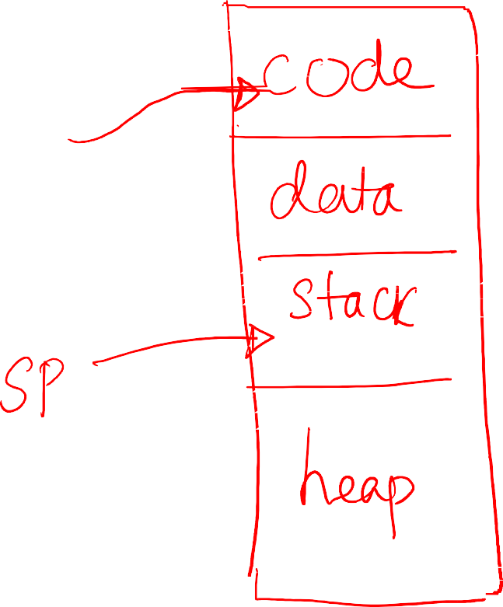



Process Execution
OS allocates memory and creates memory image
Code and data (from exe)
Stack and heap
Points CPU program counter to current instruction
Other registers may store operands, return values etc.
After setup, OS is out of the way and process executes directly on CPU
56

Slide 57
How to efficiently virtualize the CPU with control?
The OS needs to share the physical CPU by time sharing.
Issue
Performance: How can we implement virtualization without adding excessive overhead to the system?
Control: How can we run processes efficiently while retaining control over the CPU?

Slide 58
Direct Execution
Just run the program directly on the CPU.
OS | Program
1. Create entry for process list 2. Allocate memory for program 3. Load program into memory 4. Set up stack with argc / argv 5. Clear registers 6. Execute call main() 9. Free memory of process 10. Remove from process list | 7. Run main() 8. Execute return from main()
Without limits on running programs,
the OS wouldn’t be in control of anything and
thus would be “just a library”

Slide 59
Problem 1: Restricted Operation
What if a process wishes to perform some kind of restricted operation such as …
Issuing an I/O request to a disk
Gaining access to more system resources such as CPU or memory
Solution: Using protected control transfer
User mode: Applications do not have full access to hardware resources.
Kernel mode: The OS has access to the full resources of the machine

Slide 60
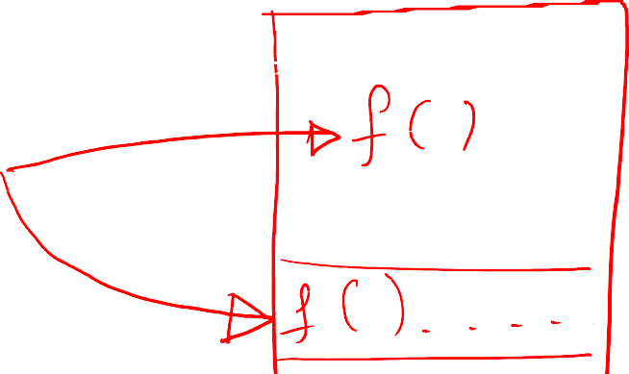


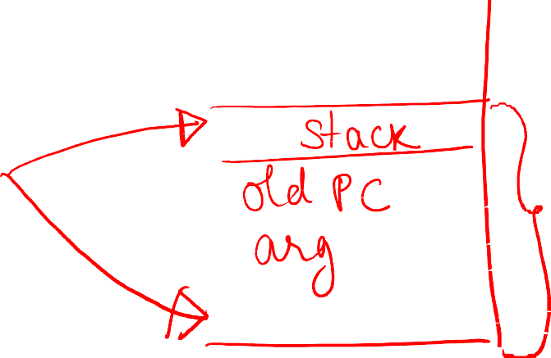

A simple function call
A function call translates to a jump instruction
A new stack frame pushed to stack and stack pointer (SP) updated
Old value of PC (return value) pushed to stack and PC updated
Stack frame contains return value, function arguments etc.
4

Slide 61
How is a system call different?
CPU hardware has multiple privilege levels
One to run user code: user mode
One to run OS code like system calls: kernel mode
Some instructions execute only in kernel mode
Kernel does not trust user stack
Uses a separate kernel stack when in kernel mode
Kernel does not trust user provided addresses to jump to
Kernel sets up Interrupt Descriptor Table (IDT) at boot time
IDT has addresses of kernel functions to run for system calls and other events

Slide 62


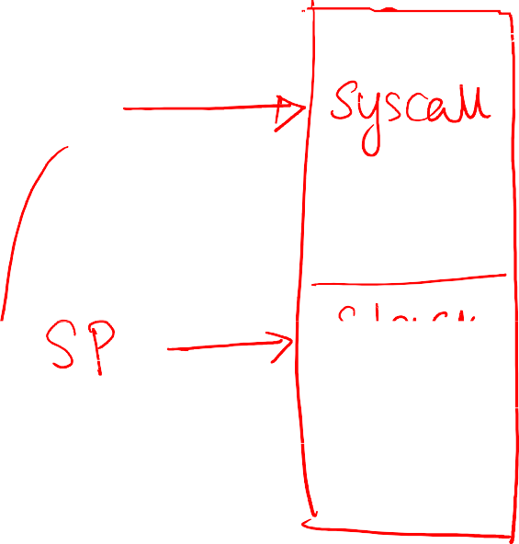


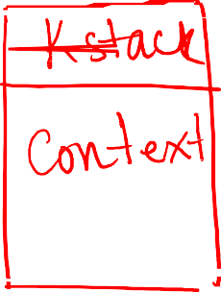



Mechanism of system call: trap instruction
When system call must be made, a special trap instruction is run (usually hidden from user by libc)
Trap instruction execution
Move CPU to higher privilege level
Switch to kernel stack
Save context (old PC, registers) on kernel stack
Look up address in IDT and jump to trap handler function in OS code

Slide 63



More on the trap instruction
Trap instruction is executed on hardware in following cases:
System call (program needs OS service)
Program fault (program does something illegal, e.g., access memory it doesn’t have access to)
Interrupt (external device needs attention of OS, e.g., a network packet has arrived on network card)
Across all cases, the mechanism is: save context on kernel stack and switch to OS address in IDT
IDT has many entries: which to use?
System calls/interrupts store a number in a CPU register before calling trap, to identify which IDT entry to use

Slide 64


Return from trap
When OS is done handling syscall or interrupt, it calls a special instruction return-from-trap
Restore context of CPU registers from kernel stack
Change CPU privilege from kernel mode to user mode
Restore PC and jump to user code after trap
User process unaware that it was suspended, resumes execution as always
Must you always return to the same user process from kernel mode? No
Before returning to user mode, OS checks if it must switch to another process

Slide 65
System Call
Allow the kernel to carefully expose certain key pieces of functionality to user program, such as …
Accessing the file system
Creating and destroying processes
Communicating with other processes
Allocating more memory

Slide 66
System Call (Cont.)
Trap instruction
Jump into the kernel
Raise the privilege level to kernel mode
Return-from-trap instruction
Return into the calling user program
Reduce the privilege level back to user mode

Slide 67
Limited Direction Execution Protocol
OS @ boot
(kernel mode)
Hardware
initialize trap table
remember address of …
syscall handler
OS @ run
(kernel mode)
Hardware
Program
(user mode)
Create entry for process list
Allocate memory for program
Load program into memory
Setup user stack with argv
Fill kernel stack with reg/PC
return-from -trap
restore regs from kernel stack
move to user mode
jump to main
Run main()
…
Call system
trap into OS

Slide 68
Limited Direction Execution Protocol (Cont.)
OS @ run
(kernel mode)
Hardware
Program
(user mode)
(Cont.)
save regs to kernel stack
move to kernel mode
jump to trap handler
Handle trap
Do work of syscall
return-from-trap
restore regs from kernel stack
move to user mode
jump to PC after trap
…
return from main
trap (via exit())
Free memory of process
Remove from process list

Slide 69
Problem 2: Switching Between Processes
How can the OS regain control of the CPU so that it can switch between processes?
A cooperative Approach: Wait for system calls
A Non-Cooperative Approach: The OS takes control

Slide 70
A cooperative Approach: Wait for system calls
Processes periodically give up the CPU by making system calls such as yield.
The OS decides to run some other task.
Application also transfer control to the OS when they do something illegal.
Divide by zero
Try to access memory that it shouldn’t be able to access
Ex) Early versions of the Macintosh OS, The old Xerox Alto system
A process gets stuck in an infinite loop.
→ Reboot the machine

Slide 71
A Non-Cooperative Approach: OS Takes Control
A timer interrupt
During the boot sequence, the OS start the timer.
The timer raise an interrupt every so many milliseconds.
When the interrupt is raised :
The currently running process is halted.
Save enough of the state of the program
A pre-configured interrupt handler in the OS runs.
A timer interrupt gives OS the ability to
run again on a CPU.

Slide 72
Saving and Restoring Context
Scheduler makes a decision:
Whether to continue running the current process, or switch to a different one.
If the decision is made to switch, the OS executes context switch.

Slide 73
Context Switch
A low-level piece of assembly code
Save a few register values for the current process onto its kernel stack
General purpose registers
PC
kernel stack pointer
Restore a few for the soon-to-be-executing process from its kernel stack
Switch to the kernel stack for the soon-to-be-executing process

Slide 74
Limited Direction Execution Protocol (Timer interrupt)
OS @ boot
(kernel mode)
Hardware
initialize trap table
remember address of …
syscall handler
timer handler
start interrupt timer
start timer
interrupt CPU in X ms
OS @ run
(kernel mode)
Hardware
Program
(user mode)
Process A
…
timer interrupt
save regs(A) to k-stack(A)
move to kernel mode
jump to trap handler

Slide 75
Limited Direction Execution Protocol (Timer interrupt)
OS @ run
(kernel mode)
Hardware
Program
(user mode)
(Cont.)
Handle the trap
Call switch() routine
save regs(A) to proc-struct(A)
restore regs(B) from proc-struct(B)
switch to k-stack(B)
return-from-trap (into B)
restore regs(B) from k-stack(B)
move to user mode
jump to B’s PC
Process B
…

Slide 76
The xv6 Context Switch Code
1 # void swtch(struct context **old, struct context *new);
2 #
3 # Save current register context in old
4 # and then load register context from new.
5 .globl swtch
6 swtch:
7 # Save old registers
8 movl 4(%esp), %eax # put old ptr into eax
9 popl 0(%eax) # save the old IP
10 movl %esp, 4(%eax) # and stack
11 movl %ebx, 8(%eax) # and other registers
12 movl %ecx, 12(%eax)
13 movl %edx, 16(%eax)
14 movl %esi, 20(%eax)
15 movl %edi, 24(%eax)
16 movl %ebp, 28(%eax)
17
18 # Load new registers
19 movl 4(%esp), %eax # put new ptr into eax
20 movl 28(%eax), %ebp # restore other registers
21 movl 24(%eax), %edi
22 movl 20(%eax), %esi
23 movl 16(%eax), %edx
24 movl 12(%eax), %ecx
25 movl 8(%eax), %ebx
26 movl 4(%eax), %esp # stack is switched here
27 pushl 0(%eax) # return addr put in place
28 ret # finally return into new ctxt

Slide 77
Worried About Concurrency?
What happens if, during interrupt or trap handling, another interrupt occurs?
OS handles these situations:
Disable interrupts during interrupt processing
Use a number of sophisticate locking schemes to protect concurrent access to internal data structures.

Slide 78
Common POSIX Signals
SIGINT – control-C
SIGTERM – default for kill shell command
SIGSTP – control-Z (default action: stop process)
SIGKILL, SIGSTOP – terminate/stop process
Can’t be changed with sigaction
Why?

Slide 79
How does a Shell work?
In a basic OS, the init process is created after initialization of hardware
The init process spawns a shell like bash
Shell reads user command, forks a child, execs the command executable, waits for it to finish, and reads next command
Common commands like ls are all executables that are simply exec’ed by the shell
prompt>ls
a.txt b.txt c.txt

Slide 80
More funky things about the shell
Shell can manipulate the child in strange ways
Suppose you want to redirect output from a command to a file
prompt>ls > foo.txt
Shell spawns a child, rewires its standard output to a file, then calls exec on the child

Slide 81
Shell Assignment
A shell is a job control system
Allows programmer to create and manage a set of programs to do some task
You will build your own shell in Assignment 3…
… using fork and exec system calls to create new processes…
… and the File I/O system calls we’ll see next time to link them together

Slide 82
First OS Concept: Thread of Control
Thread: Single unique execution context
Program Counter, Registers, Execution Flags, Stack, Memory State
A thread is executing on a processor (core) when it is resident in the processor registers
Resident means: Registers hold the root state (context) of the thread:
Including program counter (PC) register & currently executing instruction
PC points at next instruction in memory
Instructions stored in memory
Including intermediate values for ongoing computations
Can include actual values (like integers) or pointers to values in memory
Stack pointer holds the address of the top of stack (which is in memory)
The rest is “in memory”
A thread is suspended (not executing) when its state is not loaded (resident) into the processor
Processor state pointing at some other thread
Program counter register is not pointing at next instruction from this thread
Often: a copy of the last value for each register stored in memory

Slide 83
Process vs. Thread APIs
Why have fork() and exec() system calls for processes, but just a pthread_create() function for threads?
Convenient to fork without exec: put code for parent and child in one executable instead of multiple
It will allow us to programmatically control child process’ state
By executing code before calling exec() in the child
We’ll see this in the case of File I/O next time
Windows uses CreateProcess() instead of fork()
Also works, but a more complicated interface

Slide 84
Threads vs. Processes
If we have two tasks to run concurrently, do we run them in separate threads, or do we run them in separate processes?
Depends on how much isolation we want
Threads are lighter weight [why?]
Processes are more strongly isolated

Slide 85
Conclusion
Process: execution environment with Restricted Rights
Address Space with One or More Threads
Owns memory (address space)
Owns file descriptors, file system context, …
Encapsulate one or more threads sharing process resources
Interrupts
Hardware mechanism for regaining control from user
Notification that events have occurred
User-level equivalent: Signals
Native control of Process
Fork, Exec, Wait, Signal

